Slide 1


ClimateWins
Machine Learning with Python
Sam Monteath
January 2026
github.com/SamMonteath/ClimateWins_Supervised_Machine_Learning

Slide 2
Objective
Using Machine Learning to help predict the consequences of Climate Change
Potential Hypotheses to be investigated:
Daily temperature can be accurately predicted from other weather variables
Extreme weather events can be classified using preceding weather conditions
Location identity can be predicted from weather patterns alone
With each of these looked at over time, as the Earth gets hotter

Slide 3
Data
The data set consists of weather observations from 18 different weather stations across Europe, which contain data ranging from the late 1800s to 2022.
Recordings exist for almost every day with values such as temperature, wind speed, snow, global radiation and more.
This data is collected by the European Climate Assessment & Data Set project.
Potential Data Biases
The data is European – often North European - what we learn from this may not be applicable in other regions
This data stretches back some time, whereas the effects of climate change are happening rapidly – what used to happen may not anymore, so it may be hard to make current predictions
I believe this is purely scientifically collated data, but am conscious that Climate Change science is still disputed, and some data may be more selectively chosen to promote one view over another.
Accuracy
I have performed regular checks on the data as used it. This has revealed occasional issues, such as the same temperature being recorded at one location for a full year. Where this has occurred – given the size of the data set it has simply been possible to use other locations and dates.

Slide 4
Optimisation
To explore the structure of the dataset, I implemented gradient descent to optimise a simple linear model.
The goal was not to perform feature selection, but to understand whether the features in the dataset could support a linear predictive relationship.
By adjusting the parameters - Thetas, Iterations, Step Sizes - and observing convergence behaviour, I was able to see how the model responded to the underlying data.
The optimisation process showed that the loss decreased consistently and converged to a stable minimum, indicating that a linear model could fit the data.
This informed the later choice of machine‑learning models, as it suggested that more complex nonlinear models might not be strictly necessary
Animation of the path of the gradient descent, showing the path to final estimated values of thetas

Slide 5
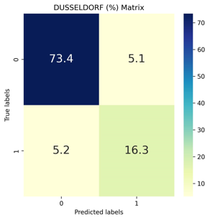
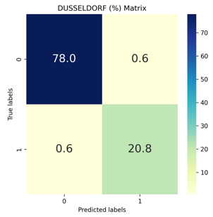
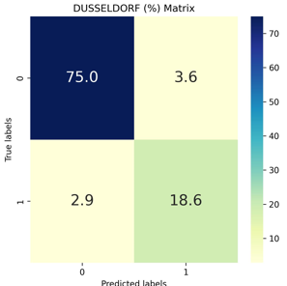
Machine Learning
I used K Nearest Neighbour, Decision Tree and Artificial Neural Network on my data set
Each of these was trained to predict “Picnic Days” i.e. days on which the weather was pleasant enough to have a picnic.
Of these, the Decision Tree brought the most accurate results, with the least need for adjustment of the algorithm.
I determined the accuracy by use of Confusion Matrices showing all locations, using the different algorithms. Example accuracy for one location, shown below:
Therefore, I recommend a Decision Tree to work further on this data and test the hypotheses.
K Nearest Neighbour | Decision Tree | Artificial Neural Network

Slide 6
Summary
My Hypotheses and how they can be tested using a decision tree:
Daily temperature can be accurately predicted from other weather variables
This is a regression task.
From the training data, the tree will naturally set thresholds e.g. if cloud cover >x, and windspeed >y and humidity <= z
and predict outcomes based on those
Extreme weather events can be classified using preceding weather conditions
This is a classification task. It will require us to define an extreme weather event e.g. temperature over x degrees for y consecutive days, or windspeed over z km/h
Having applied these labels to our data, the model can be trained to try and predict the precursor events that tend to happen before these events.
Location identity can be predicted from weather patterns alone
This is multi-class classification.
We may need to add more information about the locations to our data. This would certainly include longitude and latitude, but may also need to other information such as altitude or distance from the coast, which may affect weather.
Having given this additional information, the model can be trained to predict which of these conditions is most likely to apply to the weather pattern it sees, and therefore which is the most likely location.

Slide 7
Thank You and Questions

Slide 8






Sam Monteath
Data Analysis
sam@reasonwhy.uk
github.com/SamMonteath
linkedin.com/in/sammonteath
public.tableau.com/app/profile/sam.monteath/vizzes

